Slide 1
A Programming Career for Everybody
The path to the master programmer
Dr. Charles Severance
University of Michigan School of Information

Slide 2

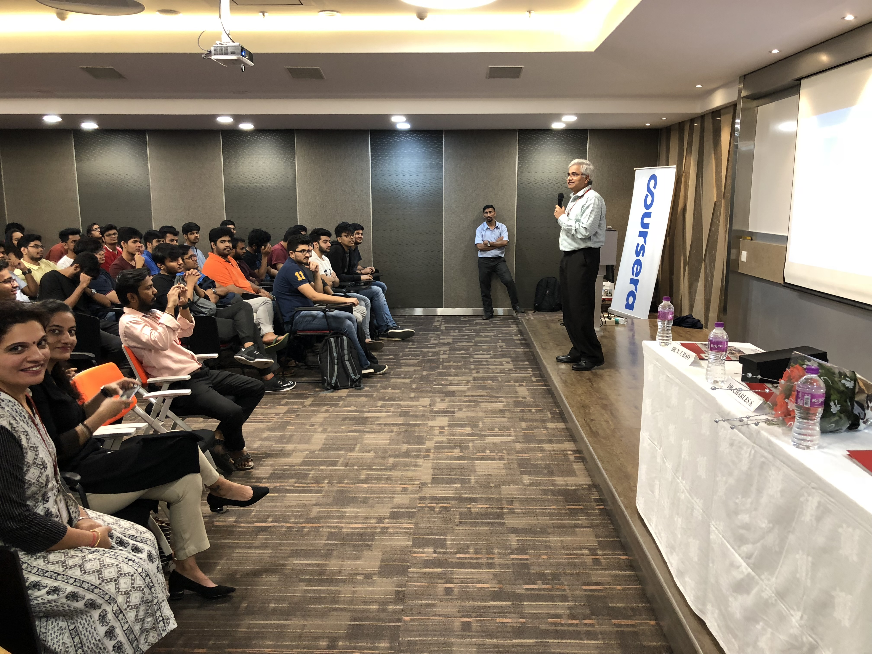
I came to India with Coursera in 2018
In addition, by 2030, India will have
the largest number of people of
college-going age - a staggering 140
million. Currently, 736 universities
educate 28.6 million students. India
will need at least another 1,500
institutions by 2030 to accommodate
this huge influx of students.
https://www.ukibc.com/wp-content/uploads/2018/03/2018-06-14-India-Education-Policy-Web-version.pdf

Slide 3
Six Years Later (halfway to 2030)
Online Degrees from Indian Universities on Coursera
BITS Pilani's BSc in Computer Science
IIT Guwahati's BSc in Data Science & AI
IIIT Hyderabad's MSc in Information Technology
Coursera for Campus
Supplement on campus and online education to extend teaching resources
Python for Everybody ☺

Slide 4
The Short Version of This Talk

Slide 5
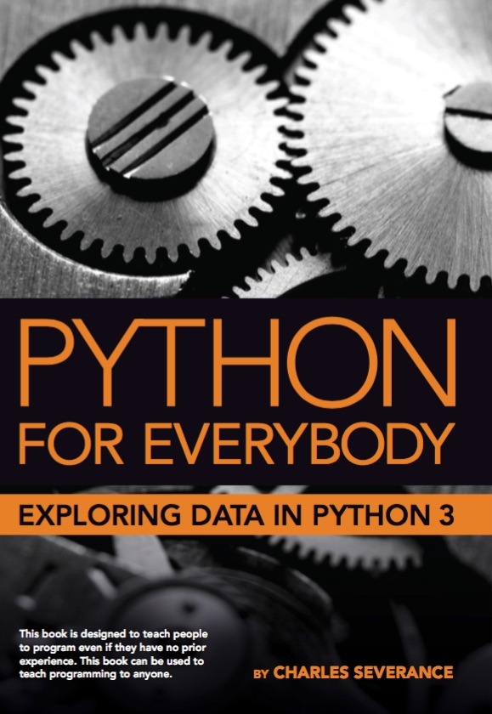
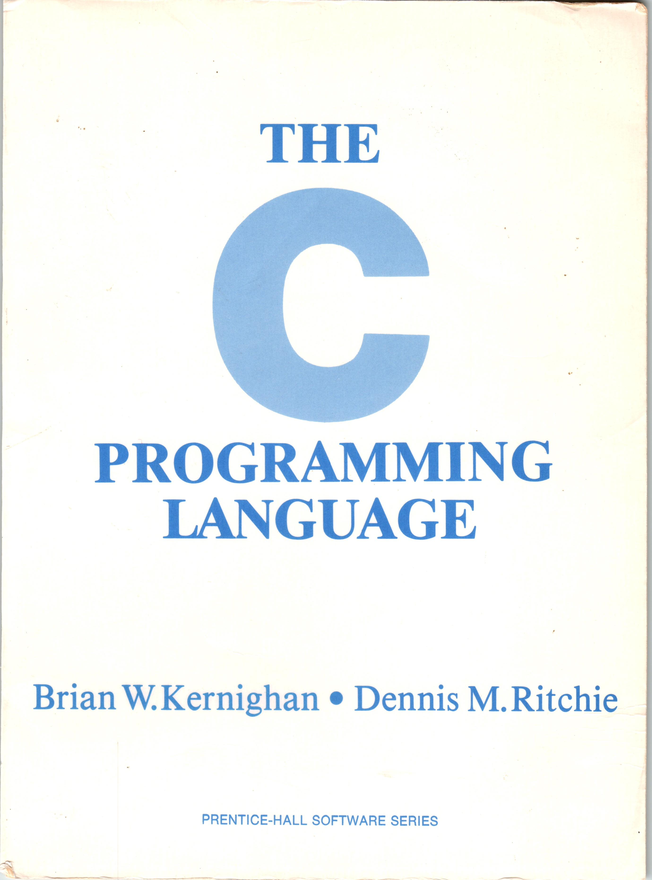
A Tale of Two Books, 10 years, and Coursera
Coursera: Python for Everybody (2013)
Coursera: C Programming for Everybody (2023)

Slide 6
Coursera: Python for Everybody
Introduced in 2013, Updated 2016, 2024
The most popular programming course in the world
Translated into 10+ Languages
In browser development environment
Many auto-graded exercises
Extra – more than just a course
Interviews
Office Hours

Slide 7
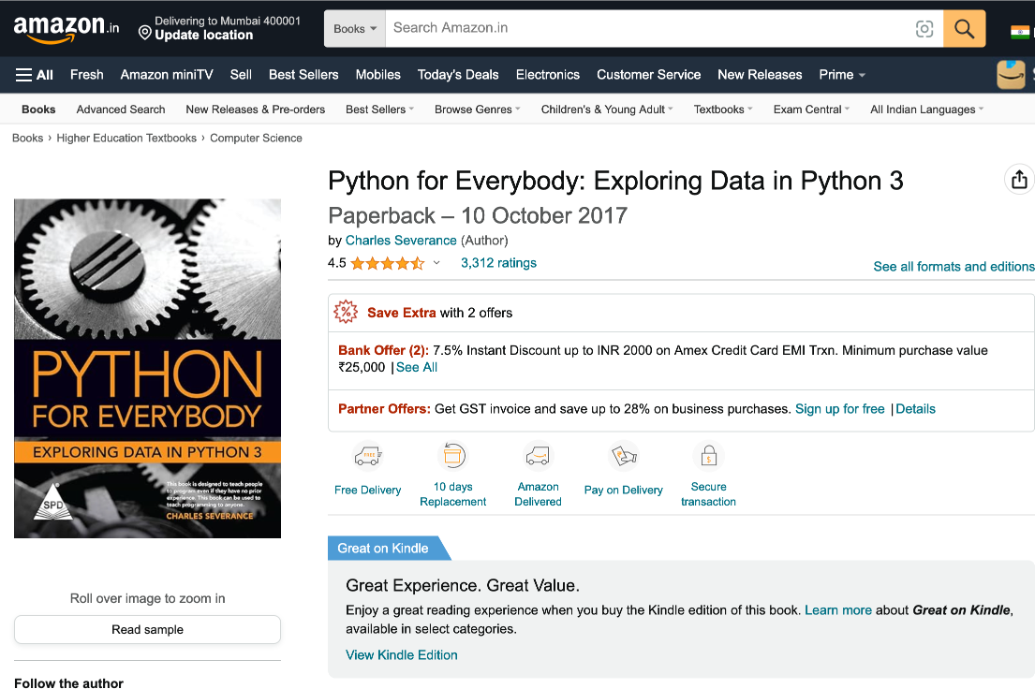

Slide 8
Coursera: C Programming for Everybody
Uses 1978 edition of book to focus on historical impact of C
Online textbook with executable examples
Accessible audio book including code samples
Starts by comparing Python to C (Rosetta Stone)
48 Auto-graded assignments
Brower-based development and compiler environment
Ends with building Python objects in C
Extras
Interviews: Brian Kernighan, Bjarne Stroustrup, Guido van Rossum

Slide 9


Coursera: C Programming for Everybody
Uses 1978 edition of book to focus on historical impact of C
Online textbook with executable examples
Accessible audio book including code samples
Starts by comparing Python to C (Rosetta Stone)
48 Auto-graded assignments
Brower-based development and compiler environment
Ends with building Python objects in C
Extras
Interviews: Brian Kernighan, Bjarne Stroustrup, Guido van Rossum

Slide 10
The path to the path to the master programmer (long version)

Slide 11
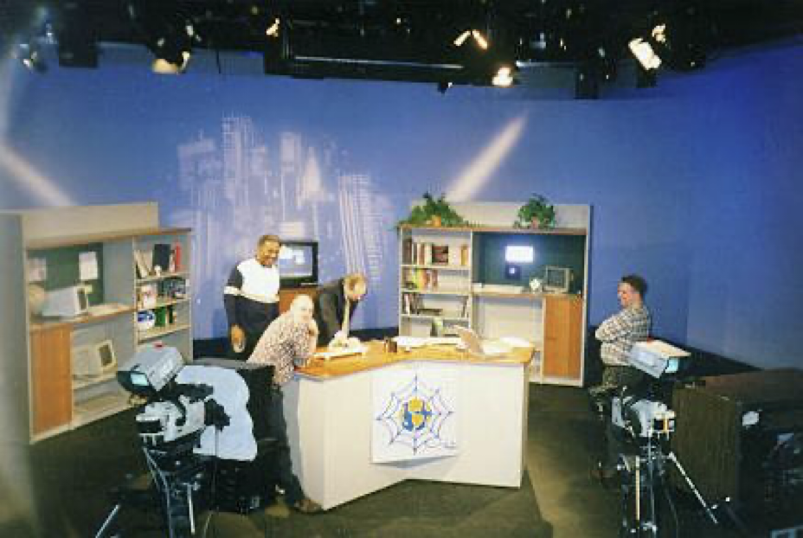
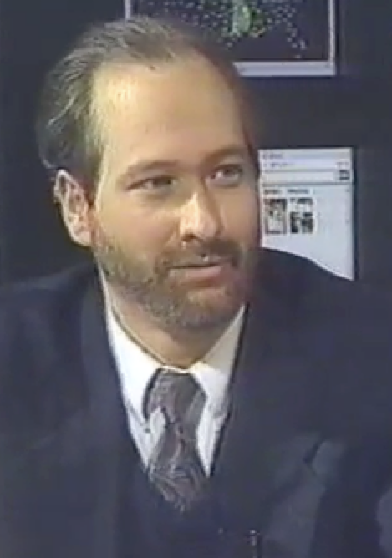
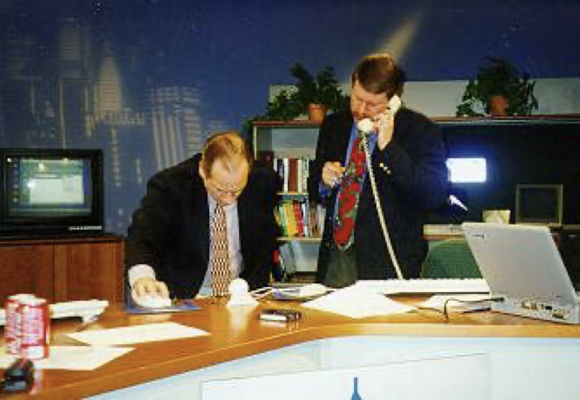
TV "Personality"
Sponsored and distributed by Cable television networks
East Lansing, MI
Promote Cable Modems
Internet:TCI (1996-97)
Nuthin' but Net (1998-99)

Slide 12
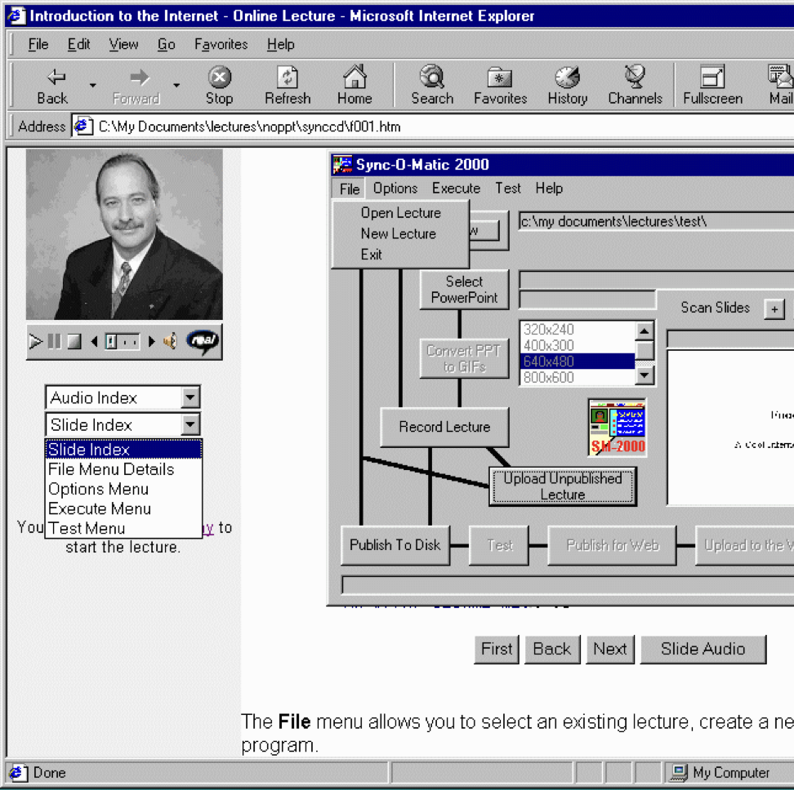
Sync-O-Matic
Michigan State University
First fully online streamed college course
Used RealAudio and 14.4 modems
Windows / Visual Basic
1997 - 1999

Slide 13
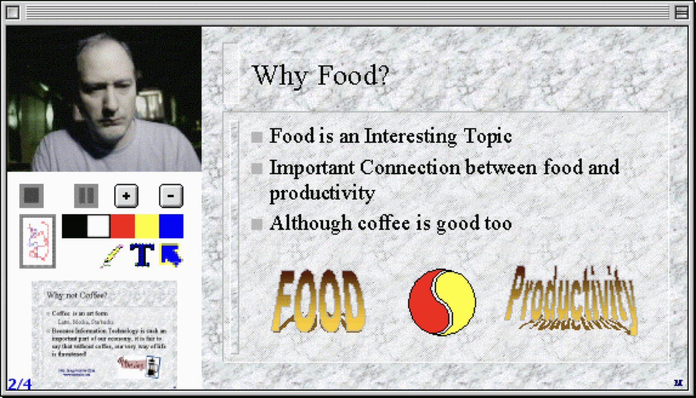
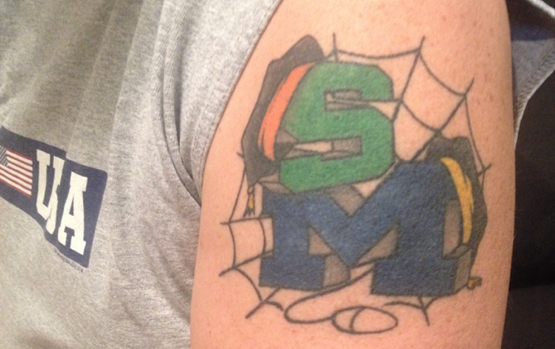
Clipboard 2000
University of Michigan
Complete rewrite – Apple / Quicktime / RealBasic
Taught C++ (EECS 280)

Slide 14
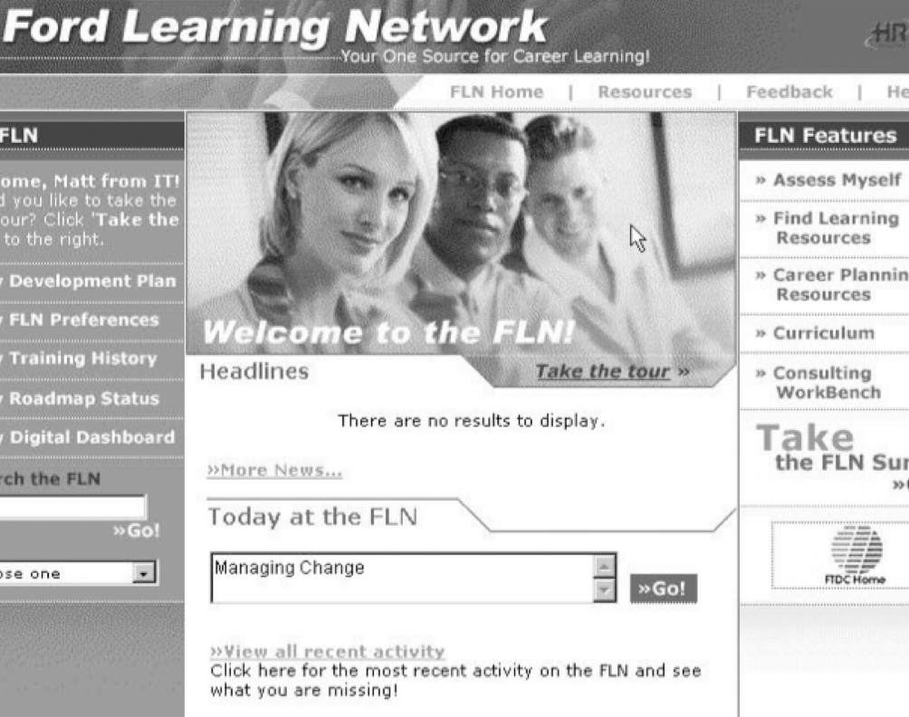
FLN (2001)
Worked at a web-based education startup
Ford
General Motors
Pepsi
Innovative System
Analyze activities and results – adjust search results
Personal learning Roadmap

Slide 15
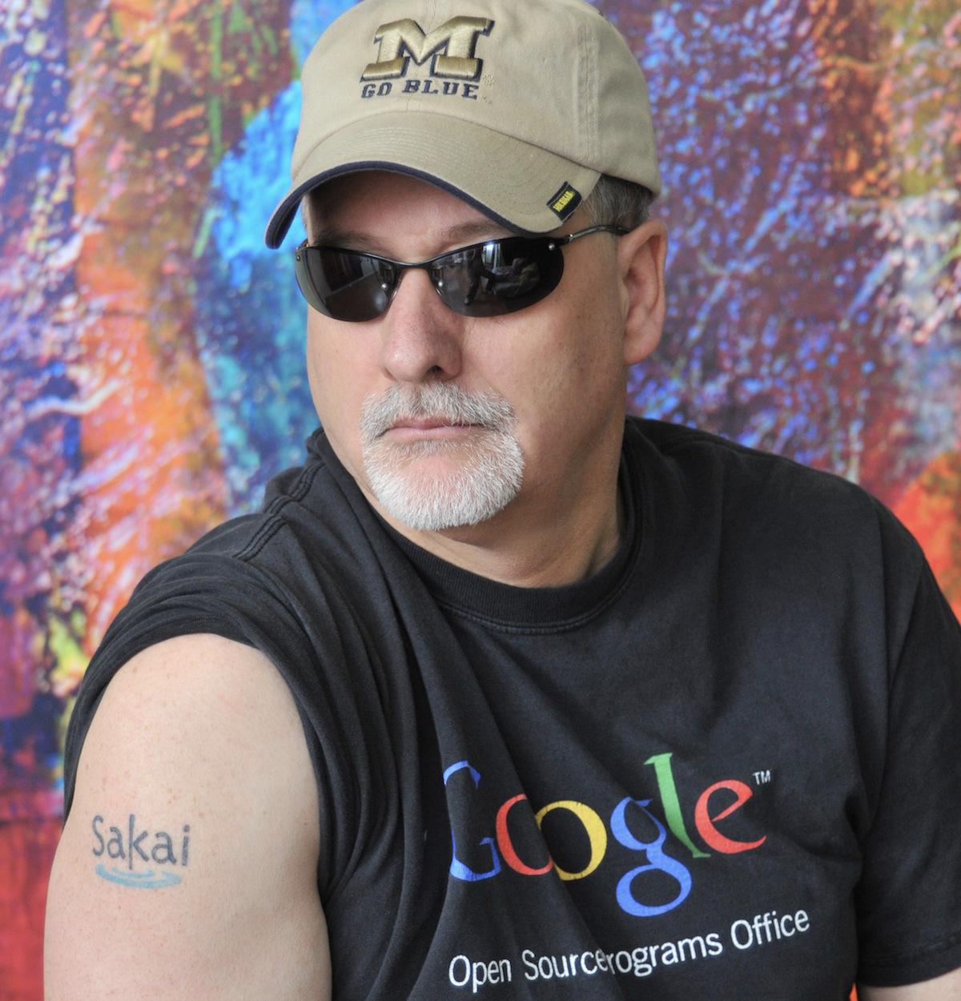
Sakai (2002- )
Back to University of Michigan
Open Source Learning Management System
Written in Java
Challenged the established vendors
Blackboard
WebCT
Angel
Desire2Learn
Reached 6% Market Share
Canvas borrowed the Sakai design in 2008
Long story (that continues)

Slide 16
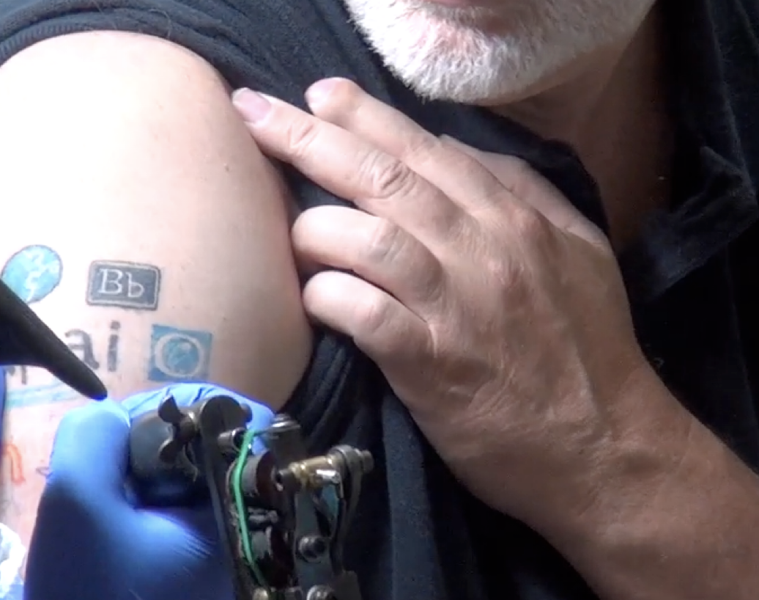
Learning Tools Interoperability (2004 - )
Sakai used our influence to develop LMS interoperability standards
Learning Tools Interoperability
Common Cartridge
Canvas did a better job on these standards then the other vendors
Including Sakai
Long story

Slide 17
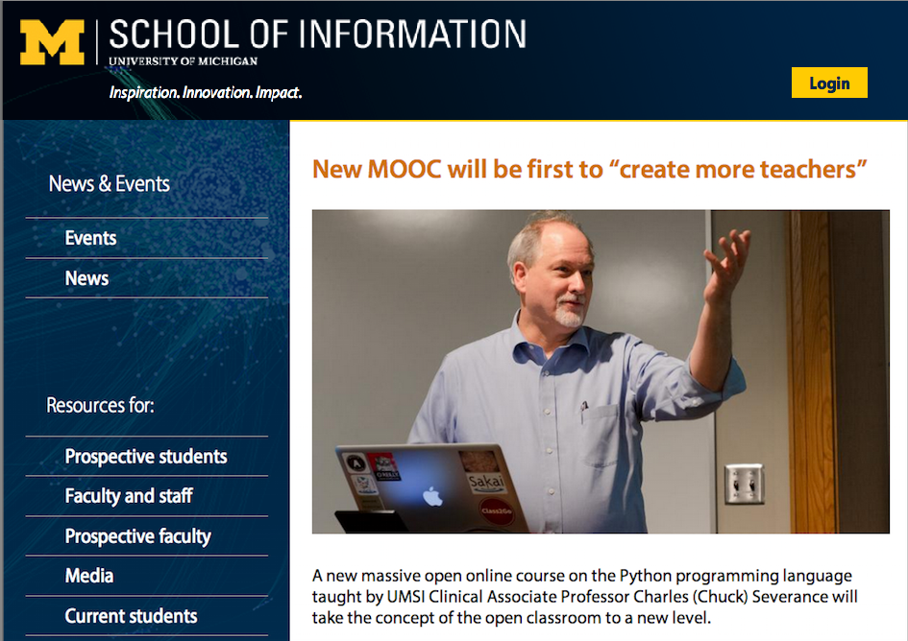
Professor (2007)
University of Michigan School Of Information
Liberal arts focus
Library school with tech focus
HCI with soft skills focus
I taught SI502 – Python for Librarians
It had to be simple
Students could not fail
Fine tuned for a number of years

Slide 18
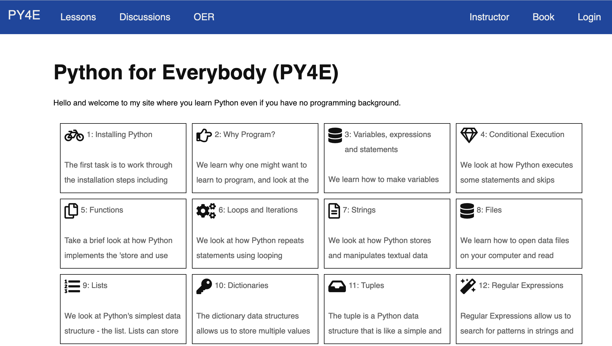
Tsugi (2010-)
PHP Based
Course Authoring Repository
Learning Tools Interoperability
Content Cartridge
Could be imported into an LMS
Sakai
Canvas
Imported into SI502 each semester

Slide 19
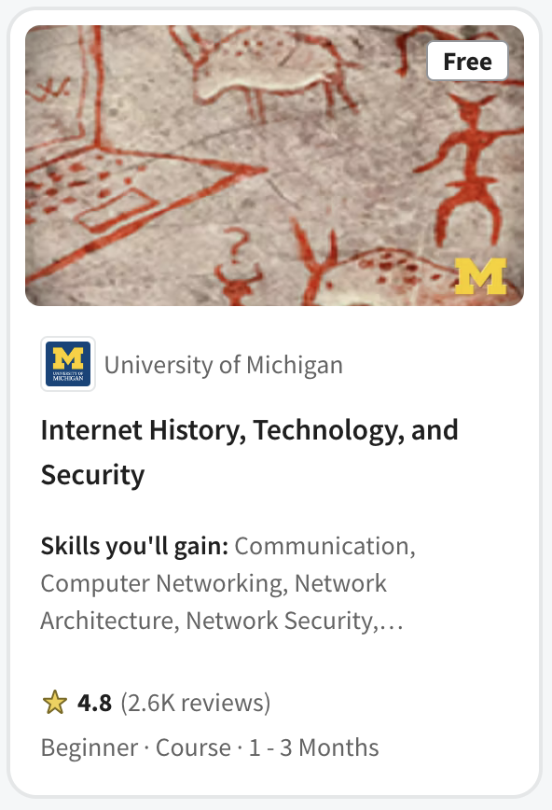
IHTS (2012)
Coursera founded in 2012
U Michigan was a founding partner
The only public university
Internet History, Technology, and Security was one of the "original six" from U Michigan
Build during the "secret phase" of Coursera
Based on two weeks of SI502 (Python)
Intended as an experiment to teach non-trivial technology to liberal arts students by moving slowly and building gradually

Slide 20
Intro Programming: Prepare you to learn
No pre-requisites or advanced math
Build content slowly
Never teach "too much'"
Talk about joy and creativity in programming
Be fun and welcoming (office hour videos with actual students)

Slide 21
Who might benefit from one great course?
Pre-college students preparing for college
College students taking a challenging course
Working adults that want to take the next step in their career
Older adults with free time and want to "see if they can do it"
Successful people that want to try "something else"

Slide 22
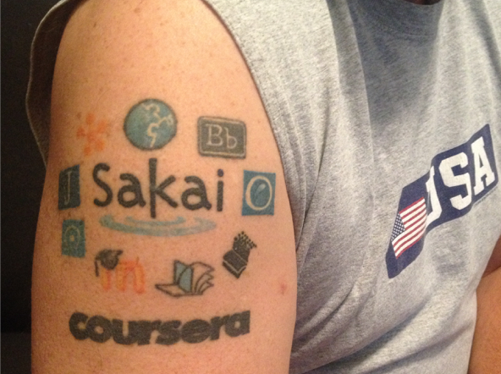
Coursera (2012)
If it only had Learning Tools Interoperability…
I could build a fully auto-graded course in a very short time
I helped code LTI 1.1 in Coursera
I became a course publisher
Coursera
edX
Canvas
Sakai
FutureLearn

Slide 23
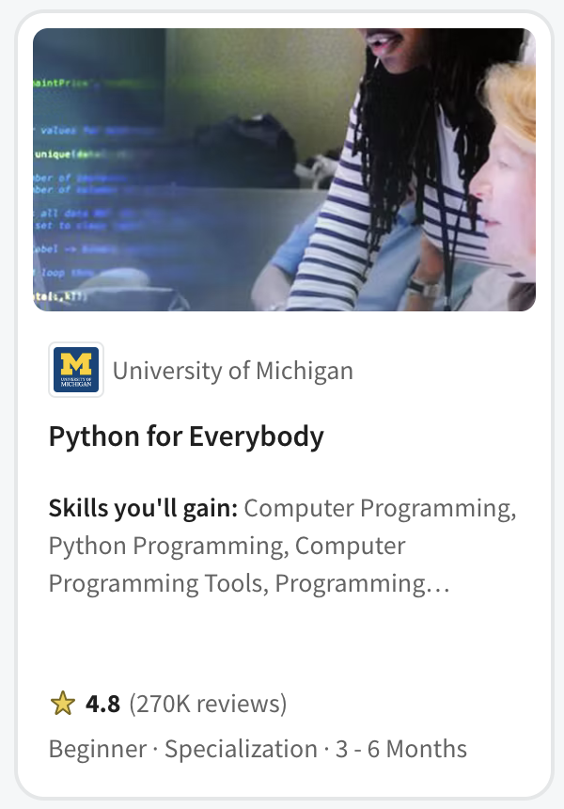
PY4E (2013)
Not a first course in Computer Science
Programing for Librarians
Quickly became the pre-requisite for
John Hopkins Data Science
Rice University Interactive Python
University of Michigan Python 3
University of Michigan Statistics with Python
University of Michigan Applied Data Science with Python
University of Michigan Masters of Applied Data Science
Popular in Coursera for Campus - India

Slide 24
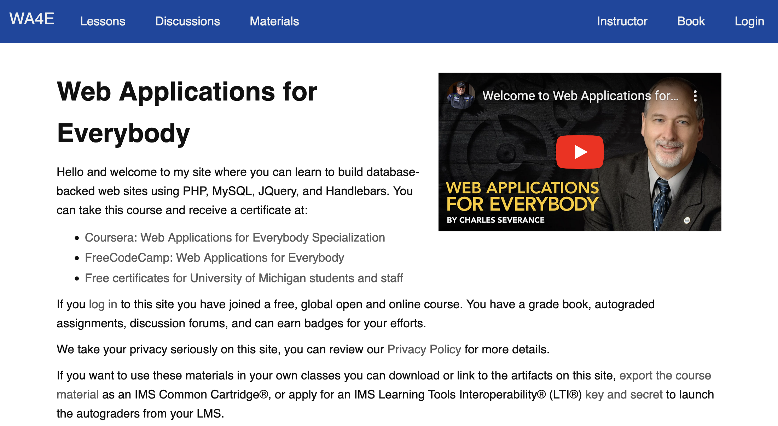
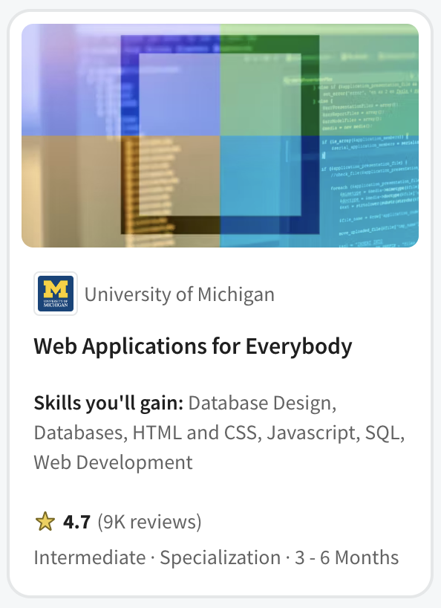
Web Applications for Everybody (2017)
PHP Course
On campus as SI572 / SI664 / SI364 (2012 – 2017)
Canvas, Coursera, edX, FutureLearn

Slide 25
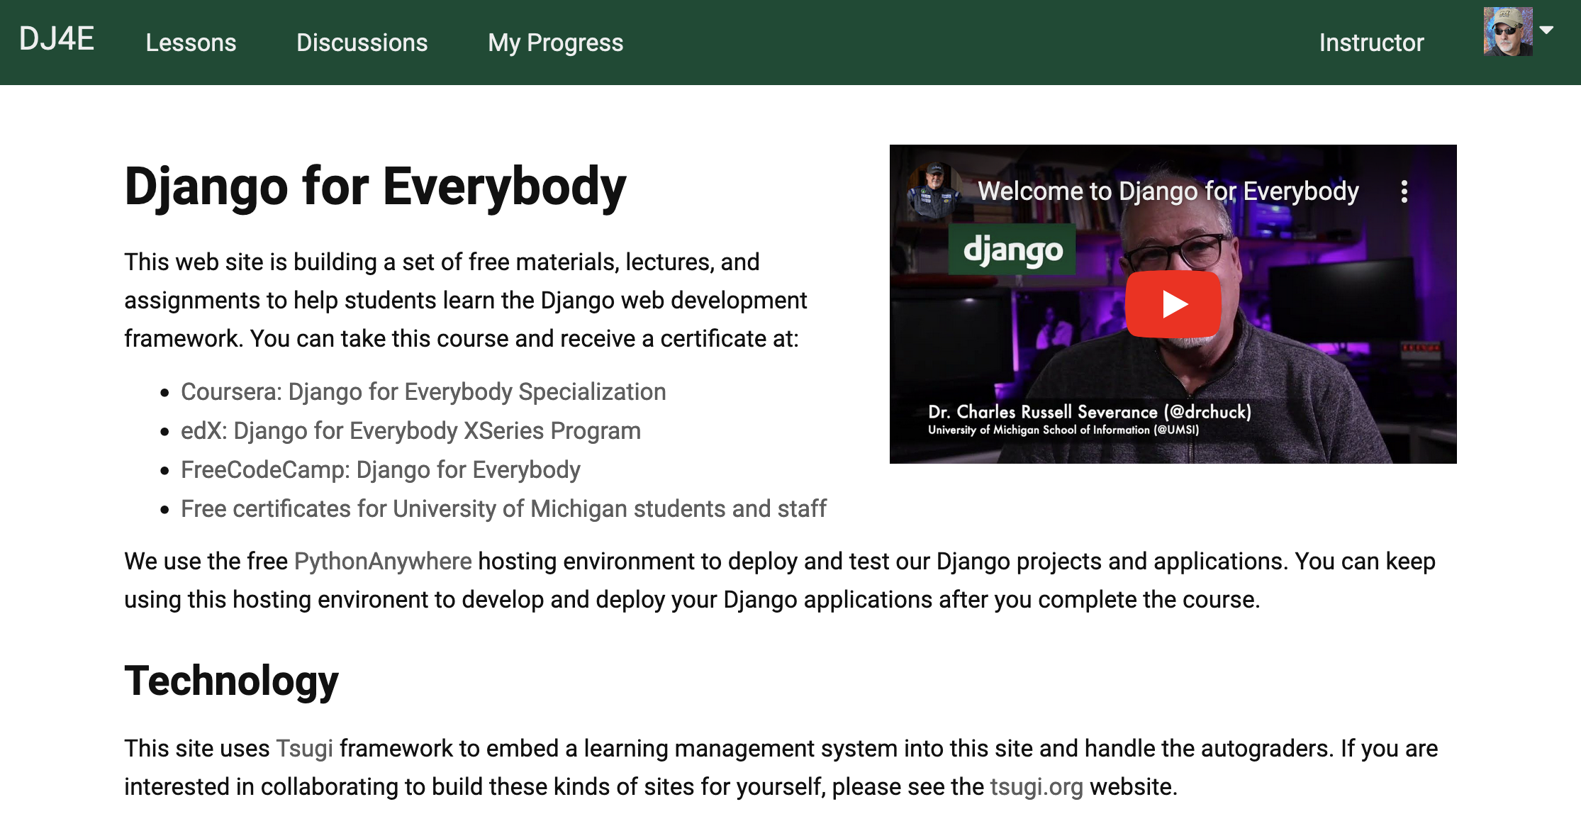
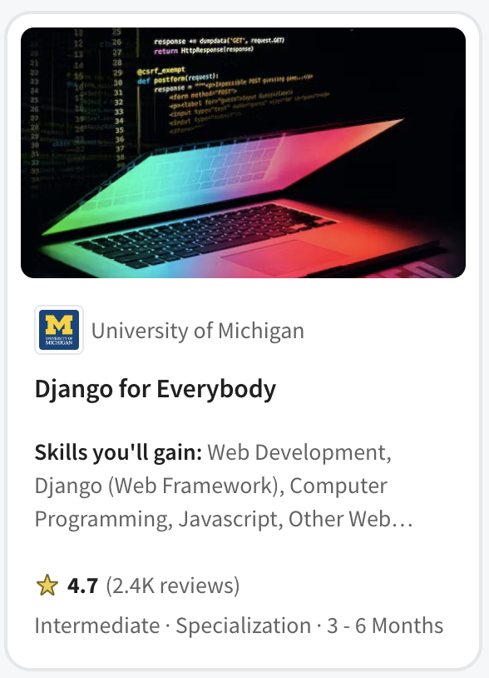
Django for Everybody (2020)
Curriculum committee said, "No more PHP!" (2016)
On campus SI664 / SI364 switched to Django
Canvas, Coursera, edX, FutureLearn

Slide 26
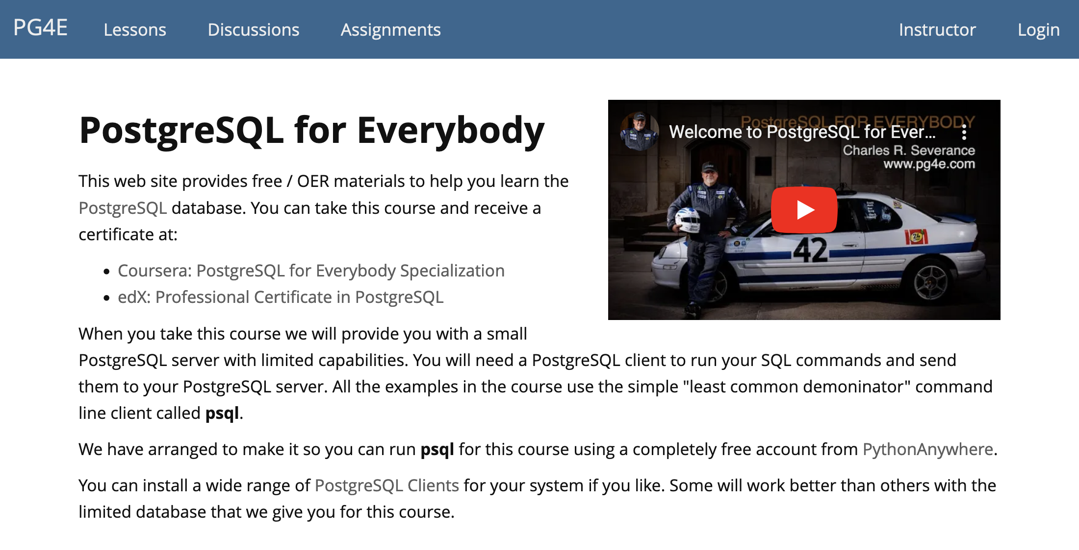
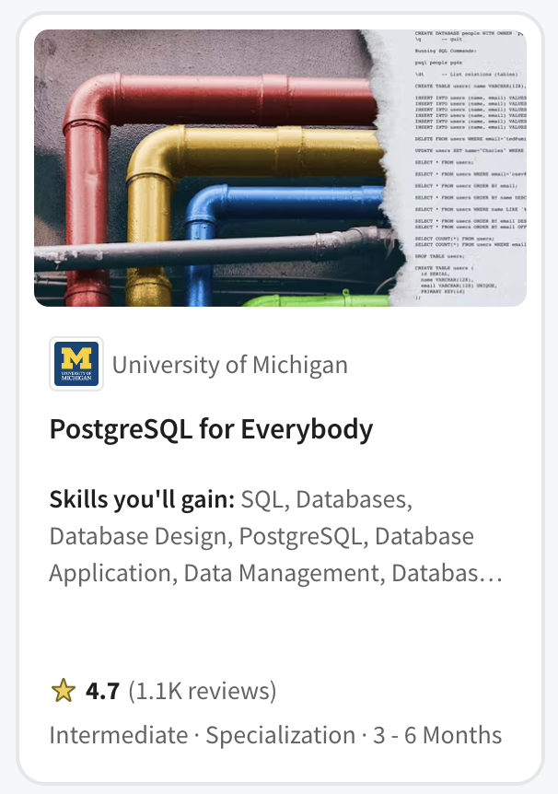
PostgreSQL for Everybody (2021)
Master of Applied Data Science on Coursera
SIADS 511 / 611
Coursera (MADS and Specialization)

Slide 27
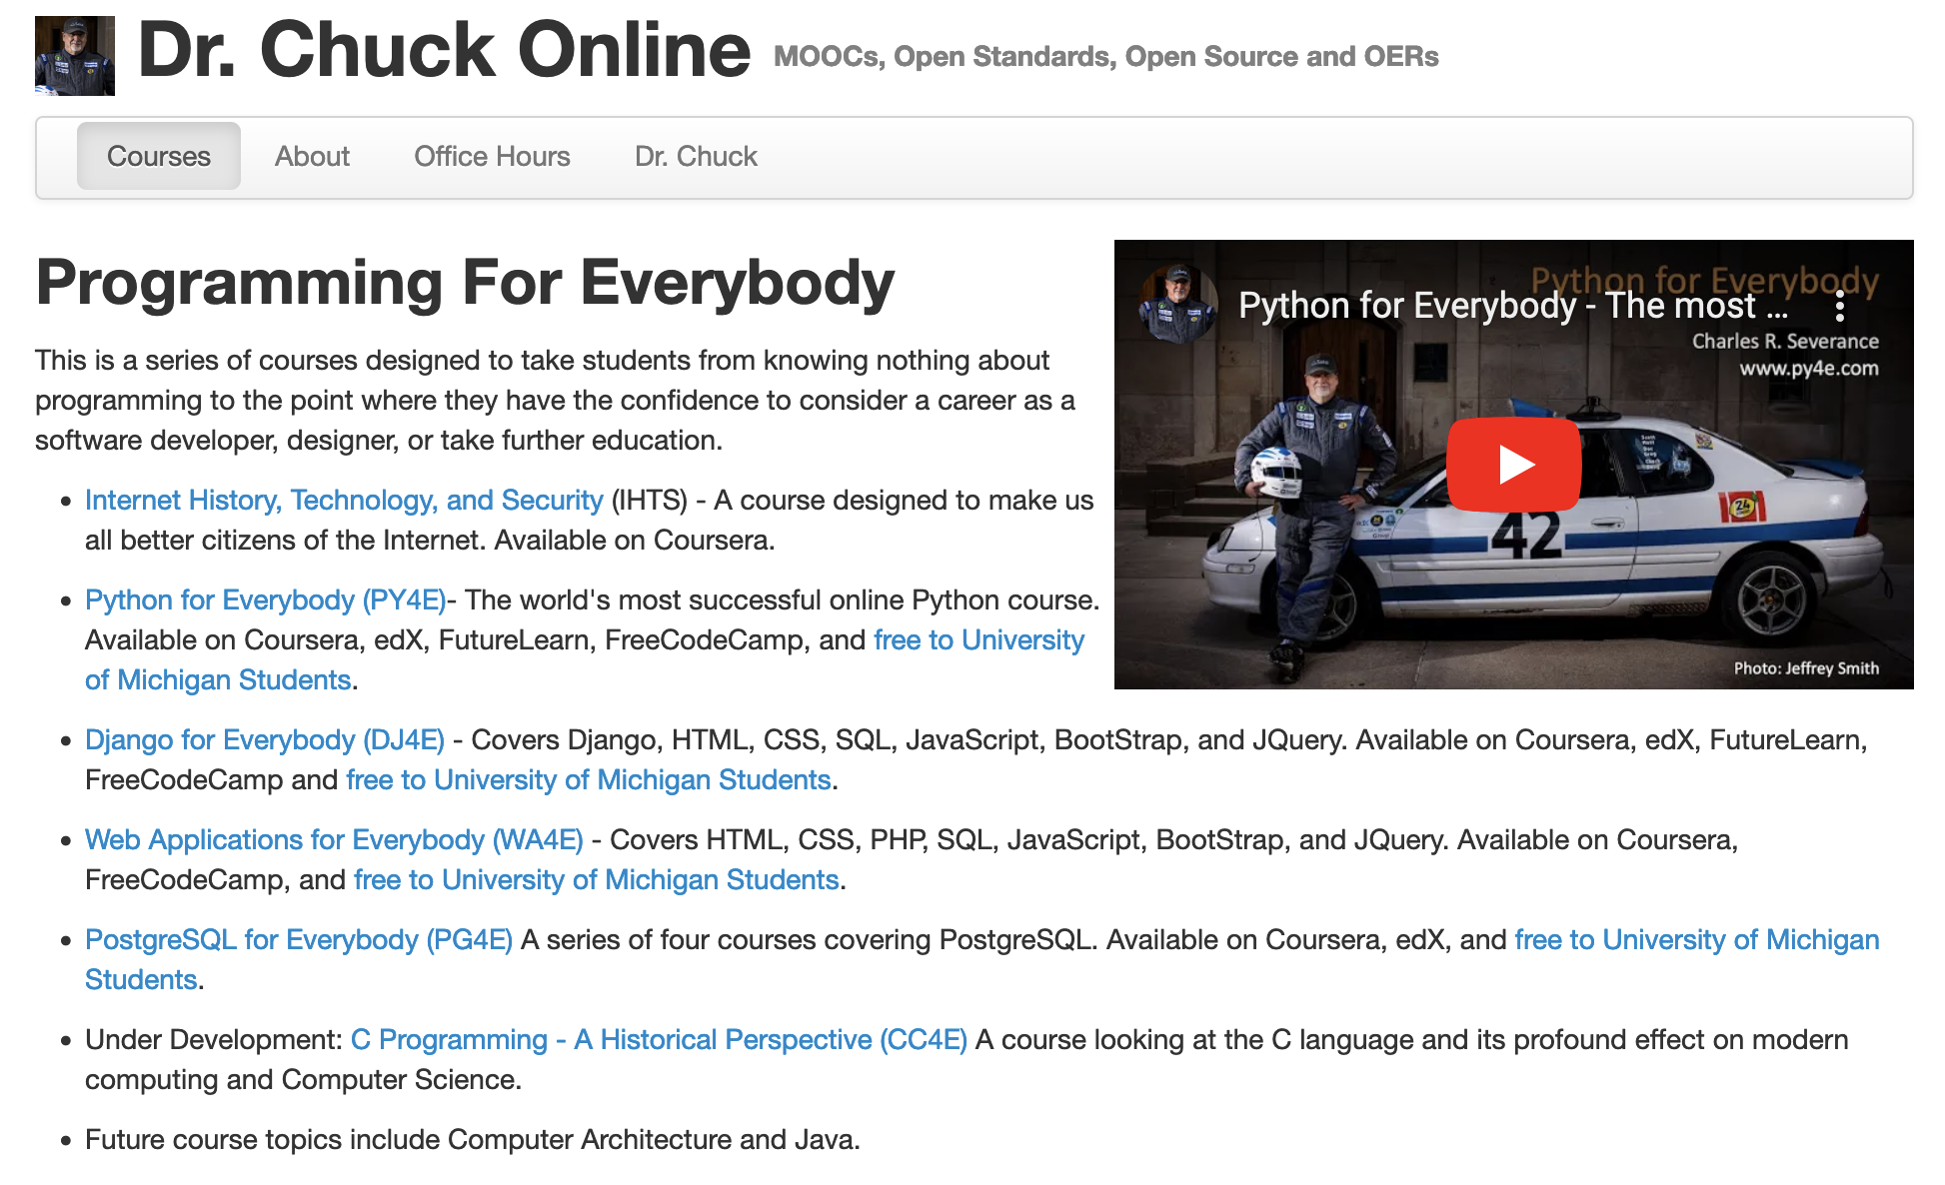

Slide 28
In Educational Technology for 25 years
The most popular programming course in the world
On Coursera
22 courses
Four specializations
A solid collection / curriculum
High school
Pre-Computer Science
Adult reskilling
Two year college
On the job training / skills Improvements
Ready to integrate into Canvas / Blackboard / Moodle / Desire2Learn

Slide 29

Every day 150 students complete one of my courses around the world

Slide 30
Dear Dr. Severance,
My name is Anne, I am a graduate from the University of California. It is a pleasure to meet you!
I recently completed your course on Internet History, Technology, and Security on Coursera. I learned so much about the innovations that make the internet possible. I do not think I would have learned so much so fast with any other course or professor.
I just wanted to say thank you very much for providing this service. My degrees are in American Studies and History, and my Masters in Library and Information Science, but your course has inspired me to pursue a more technology-focused career.
I am looking forward to exploring more of your resources and delving deeper into the world of Computer Science.
Sincerely,
Anne
Anne,
Thanks for the kind note. Your story is exactly why I built the Internet History course. It would be really cool for you to build your technology skills and then bring all your prior education and lived life experiences into organizations that make and use technology.
--Chuck

Slide 31
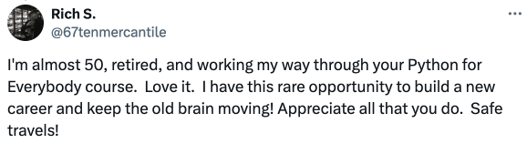
Hello,
I am a professor in astronomy and astrophysics at UM and want to become facile in python, so I can help them better when they do projects. I was looking for a course that I can do at my own pace (and download materials for a long flight, if possible) and was wondering which of your on-line courses (e.g., on Coursera) you would recommend, as there are several to choose from.
In advance, thanks for your help,
Joel N. Bregman
Professor of Astronomy

Slide 32
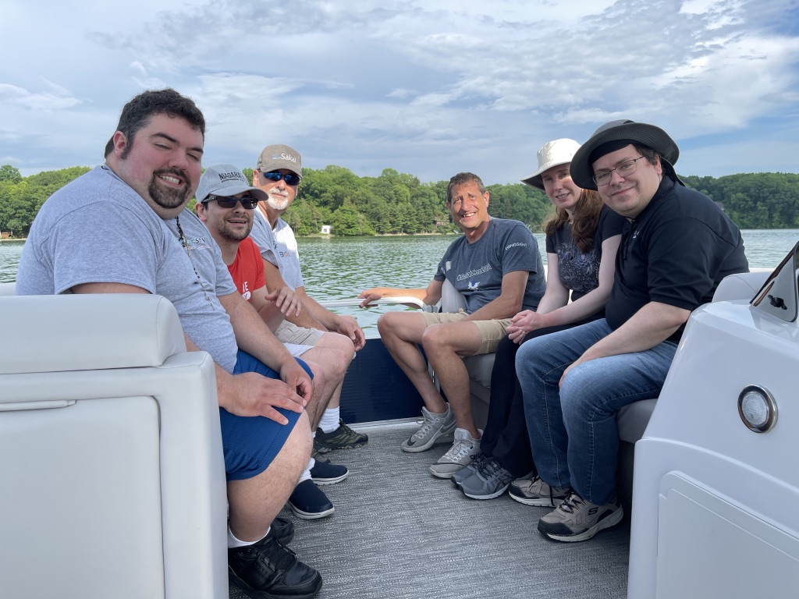
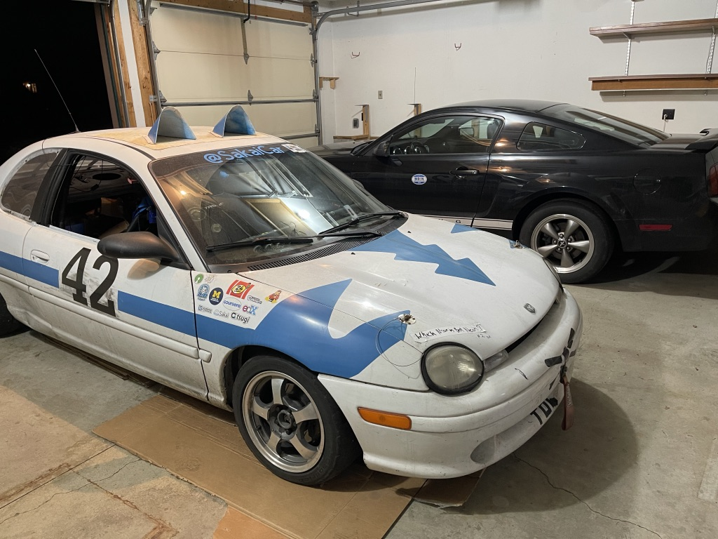

Should I slow down or even retire?

Slide 33
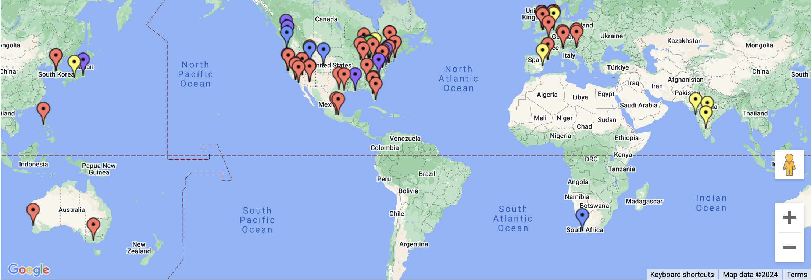
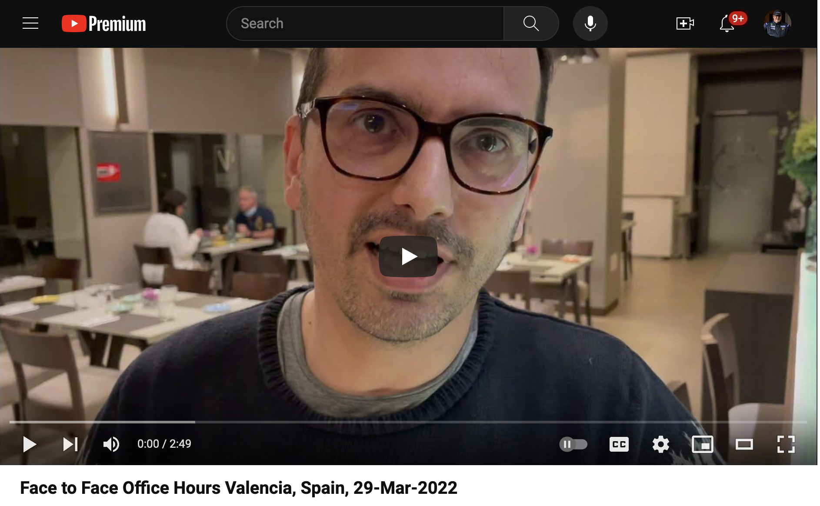

Slide 34
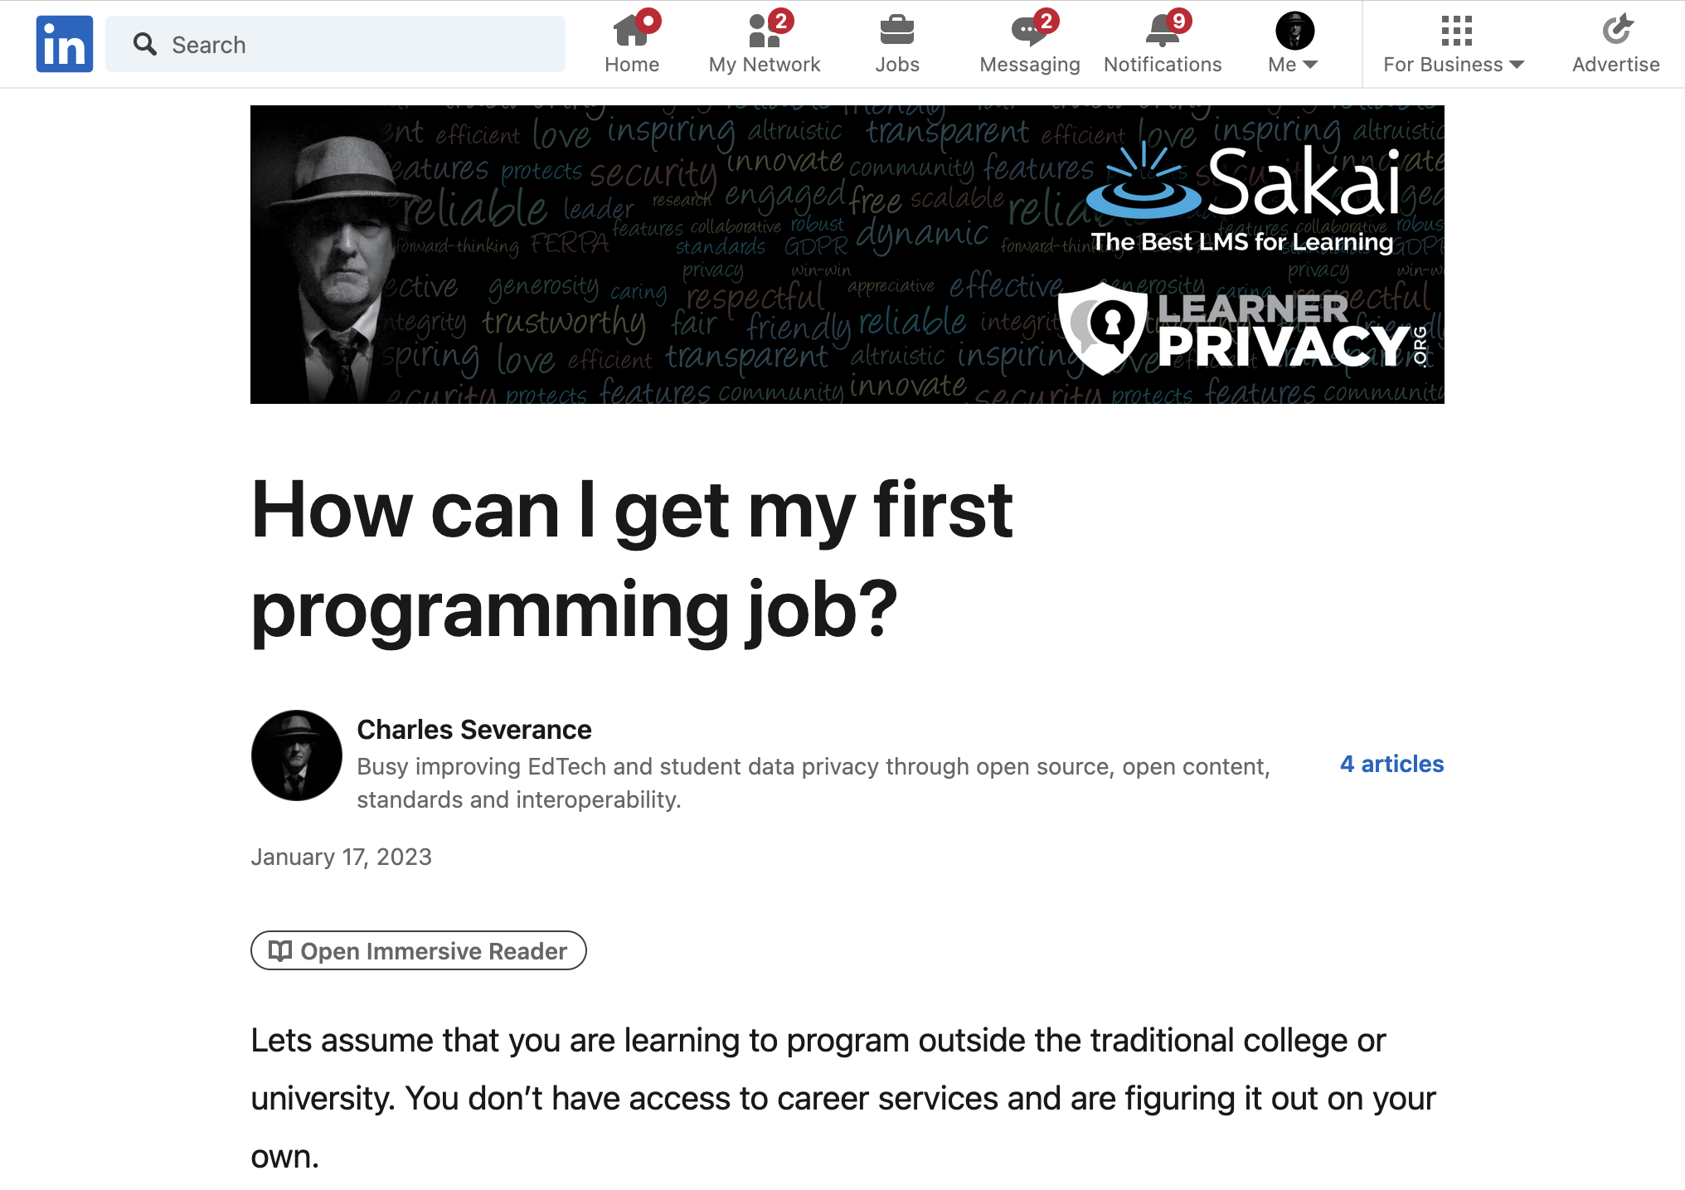

Slide 35

What kind of job can I get?

Slide 36
Would I hire the graduates of my "degree"?

Slide 37

If I would not hire my own graduates, what am I even doing?

Slide 38

A Brief Existential Crisis
Why am I here?
Have I let my students down?
Have I wasted their time?
Have I wasted my time?

Slide 39

Who would I hire?
I have met so many amazing developers over the years
Almost no Computer Scientists
Self taught / learned from mentors
Practical experience in large real-world projects
Work to build other people – great mentors
Not wizards – but quick learners

Slide 40

My next thought..

Slide 41
Who might benefit from one great course?
Pre-college students preparing for college
College students taking a challenging course
Working adults that want to take the next step in their career
Older adults with free time and want to "see if they can do it"
Successful people that want to try "something else"

Slide 42
Who could be a professional programmer?
Pre-college students preparing for college
College students taking a challenging course
Working adults that want to take the next step in their career
Older adults with free time and want to "see if they can do it"
Successful people that want to try "something else"

Slide 43
Can I develop a series of courses to train a professional programmer?

Slide 44
Professional Programming "Certificate"
No pre-requisites or advanced math
Build content slowly but advanced courses build on earlier courses
Talk about joy and creativity in programming
Be fun and welcoming (office hour videos with actual students)
Need to allocate some time and dedicate some time
One model: One year – 20 hours per week – 1000 hours
Other faster and slower models can work as well

Slide 45
The Path to the Master Programmer
???
???
???
Hired!
???
???

Slide 46
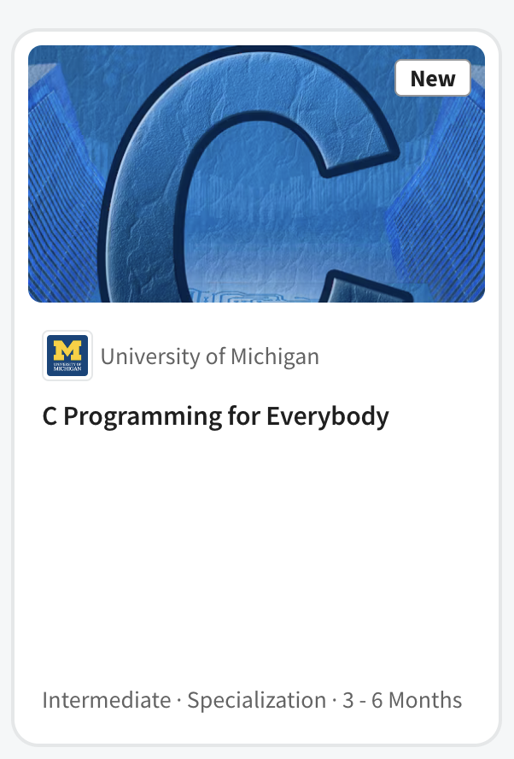
The Path to the Master Programmer (draft)
JavaScript
Intern
ship
Hired!
Hardware
Java

Slide 47
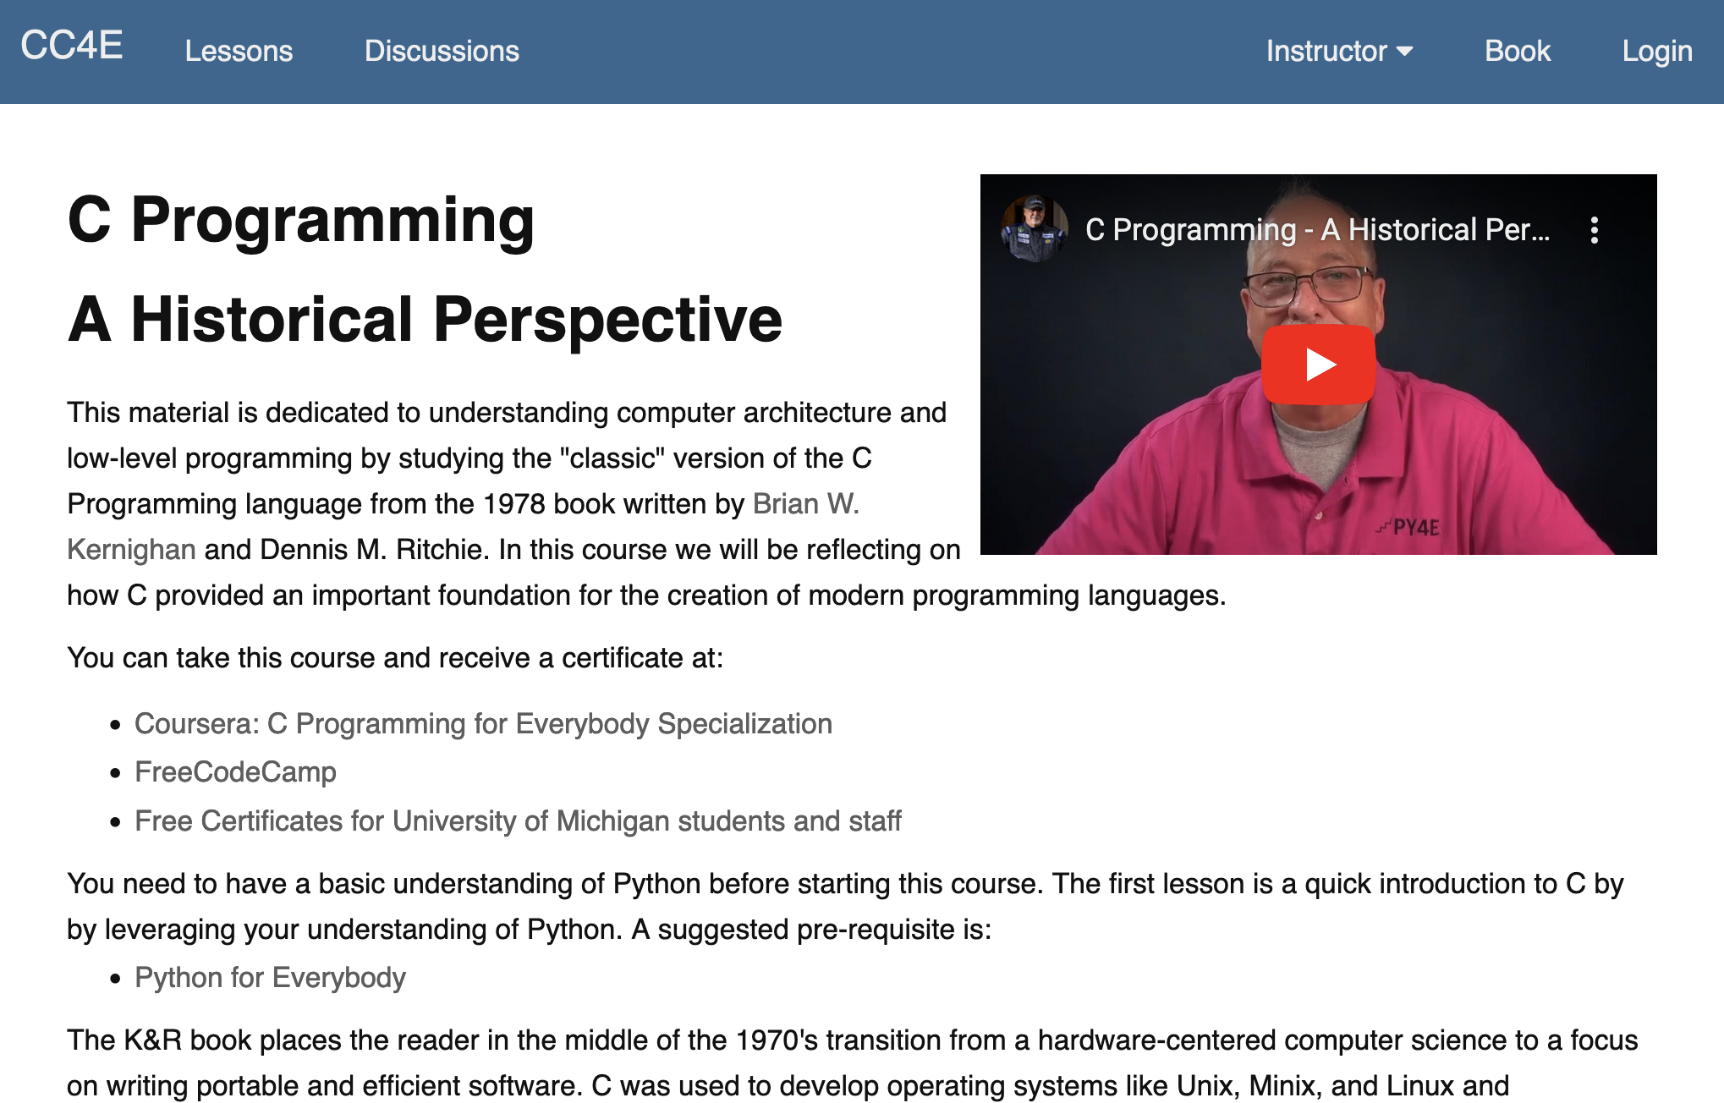
C Programming for Everybody (2023)
Based on the 1978 "C Programming" (45 years later)
Digitized, online, audiobook, accessible, annotated
Auto graders based on an in-browser C Compiler
Took 4 years to develop
Canvas, Coursera

Slide 48
Coursera: C Programming for Everybody
Uses 1978 edition of book to focus on historical impact of C
Online textbook with executable examples
Accessible audio book including code samples
Starts by comparing Python to C (Rosetta Stone)
48 Auto-graded assignments
Brower-based development and compiler environment
Focus on understanding the nature of Object Oriented Programming
Extras
Interviews: Brian Kernighan, Bjarne Stroustroup, Guido van Rossum

Slide 49
Next steps
Computer Architecture for Everybody
Modern JavaScript
Modern Java
Scalable Internships…

Slide 50
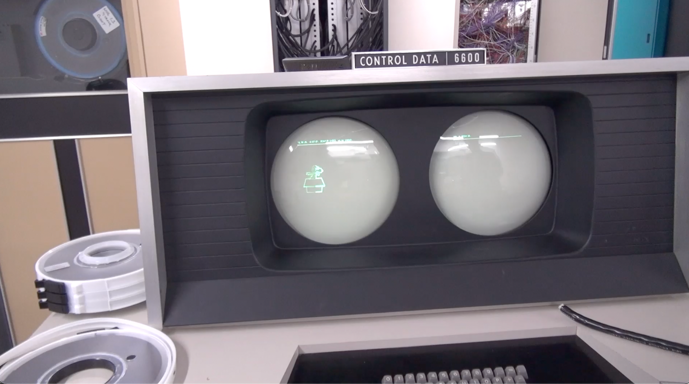
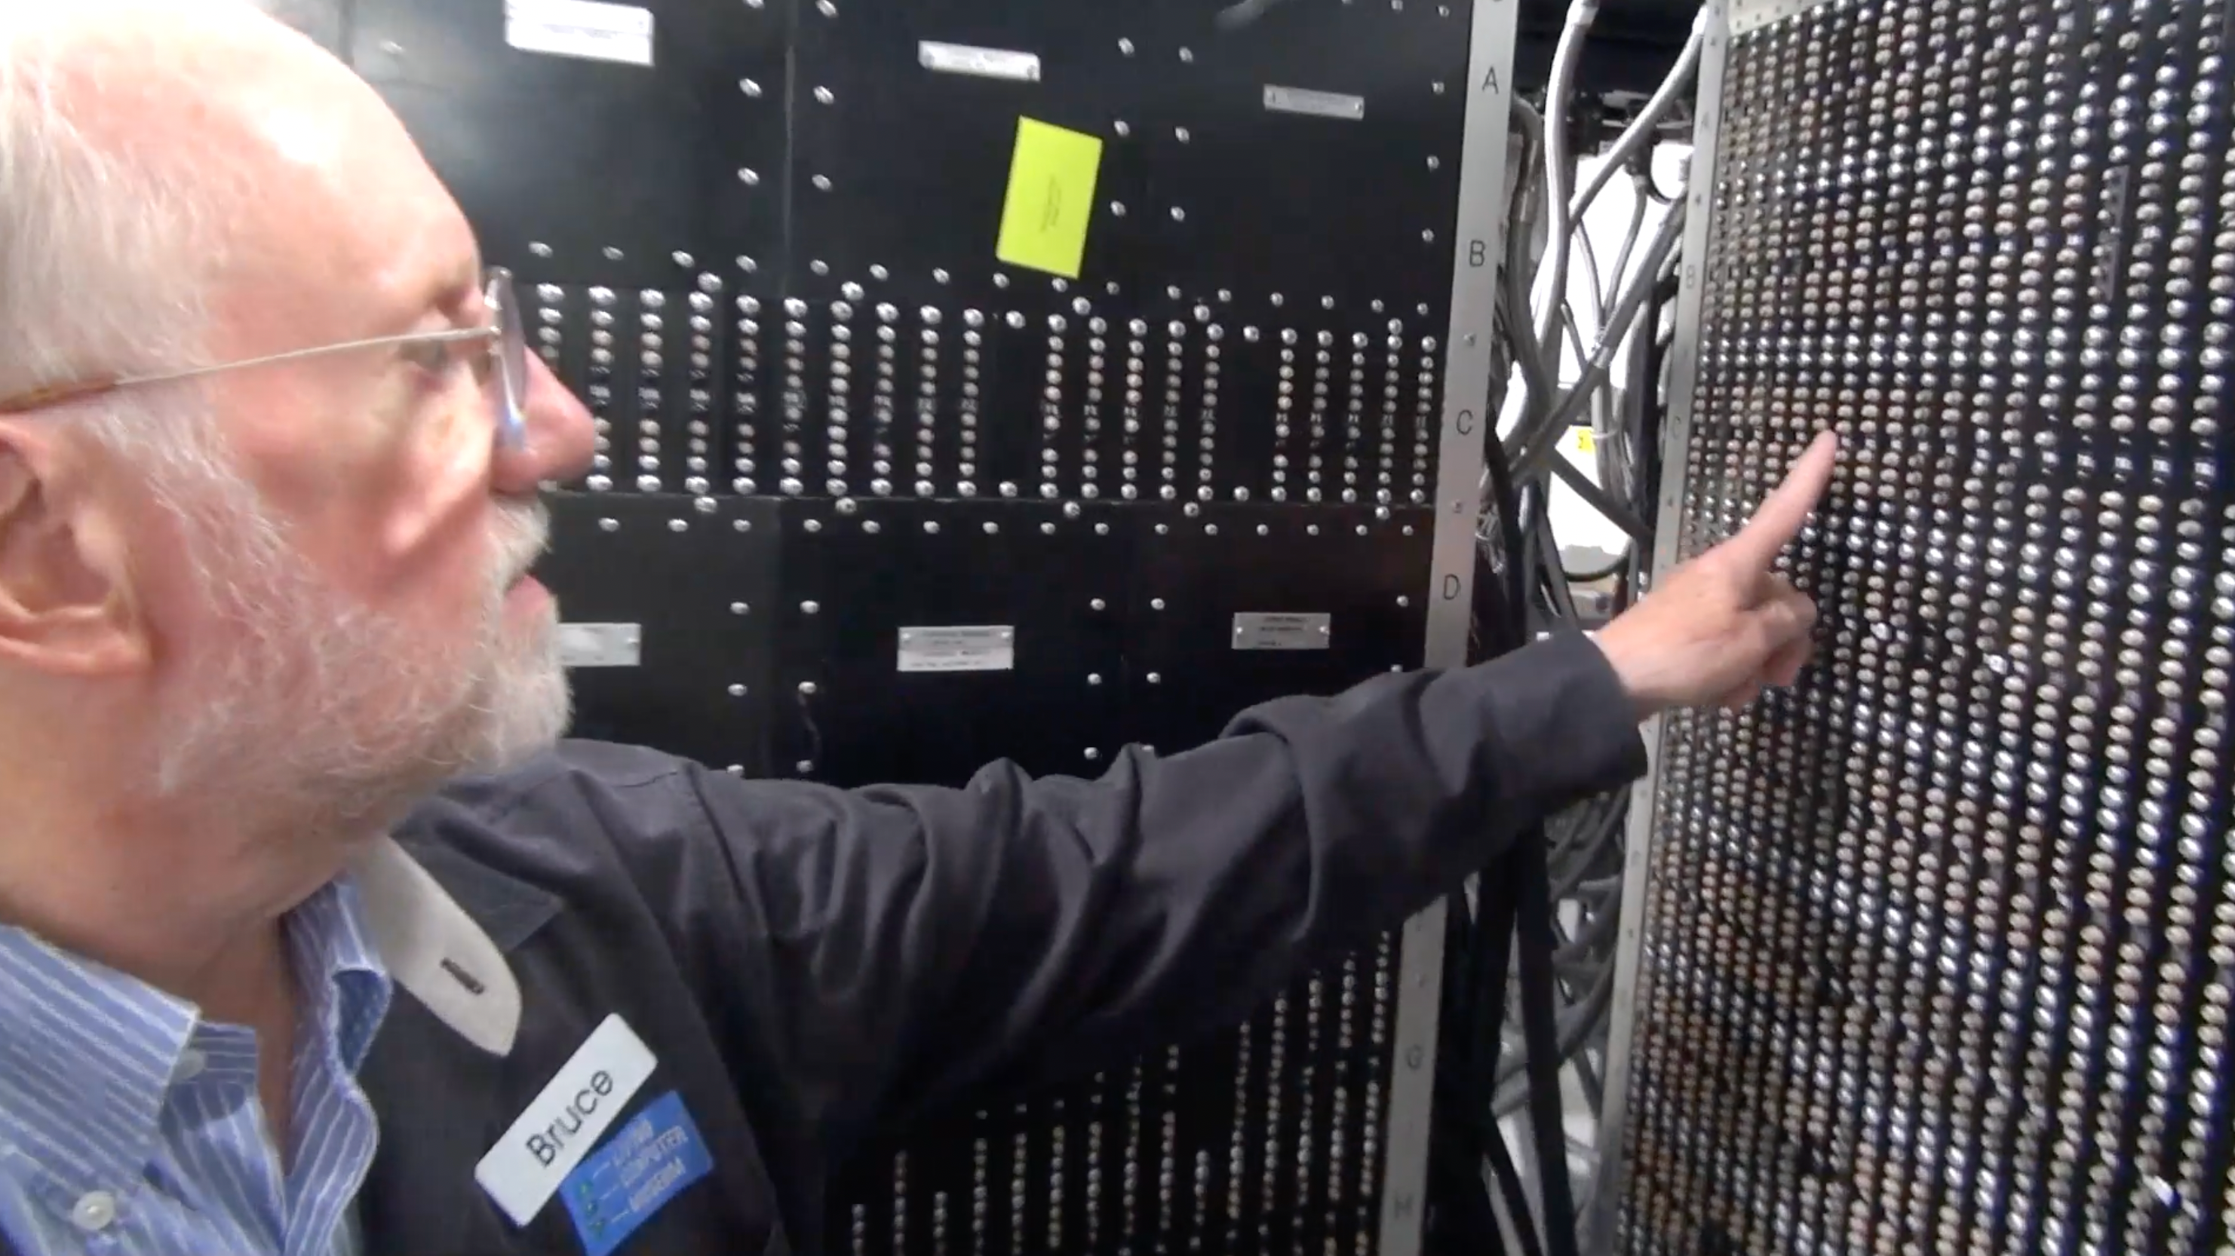
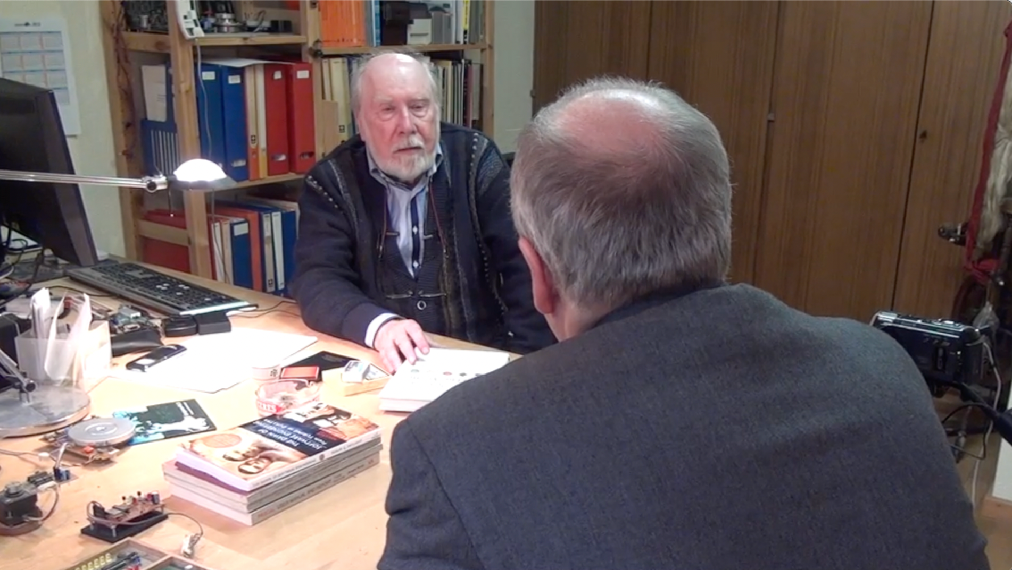
CDC 8512 - Inspired by CDC 6500
Control Data Corporation
Mid 1960’s – mid-1970’s
Dr. Chuck’s first computer
FORTRAN
Assembly Language
Pascal
https://en.wikipedia.org/wiki/CDC_6000_series#Central_processor

Slide 51
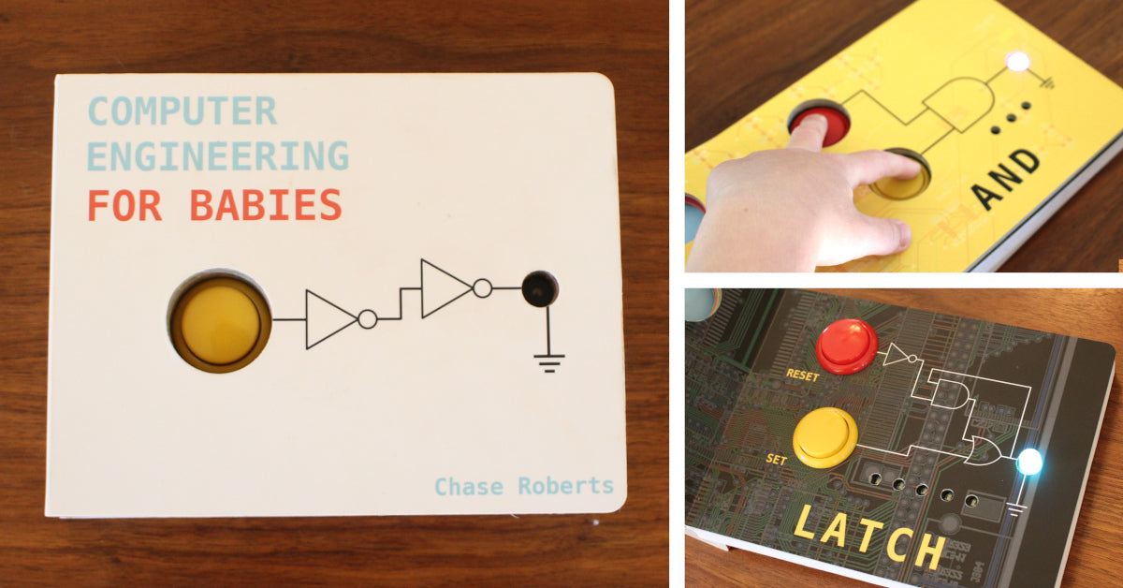

Slide 52

The Path to the Master Programmer
I have started down the path to build it
C Programming for Everybody is the first step
We will see where the path leads
Any questions?

